Slide 1


Google Machine Learning courses
Notes:
https://developers.google.com/machine-learning/crash-course

Slide 2
What you will learn
Linear Regression
Logistic Regression
Classification
Working with Numerical Data
Working with Categorical Data
Datasets, Generalization, and Overfitting
Neural Networks
Embeddings
Large Language Models
Production ML Systems
AutoML
ML Fairness

Slide 3
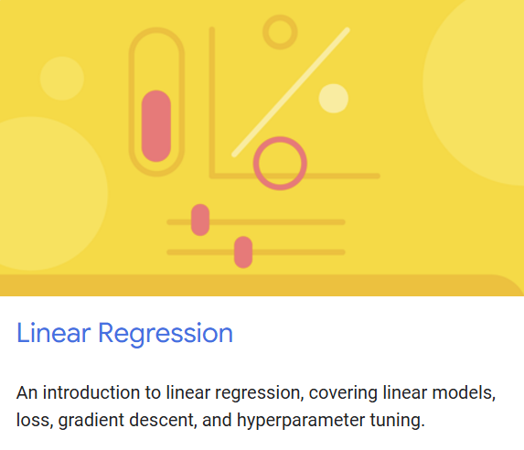
Linear regression
Notes:
https://developers.google.com/machine-learning/crash-course/linear-regression

Slide 4
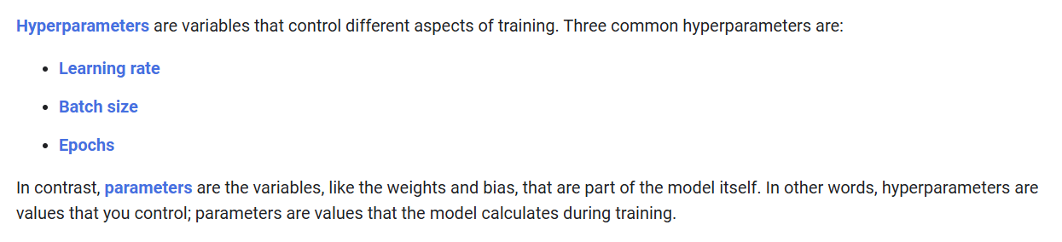
Notes:
https://developers.google.com/machine-learning/crash-course/linear-regression/hyperparameters

Slide 5


Model
User
Weights
Bias
Hyperparameters
Learning Rate
Batch Size
Epochs

Slide 6
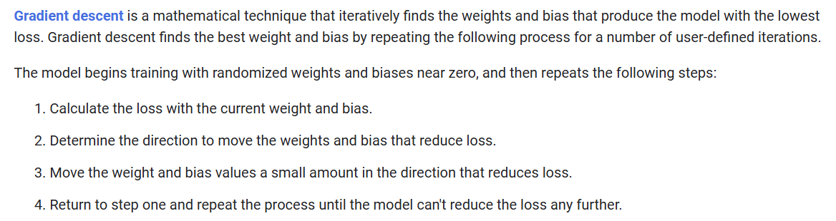

Slide 7
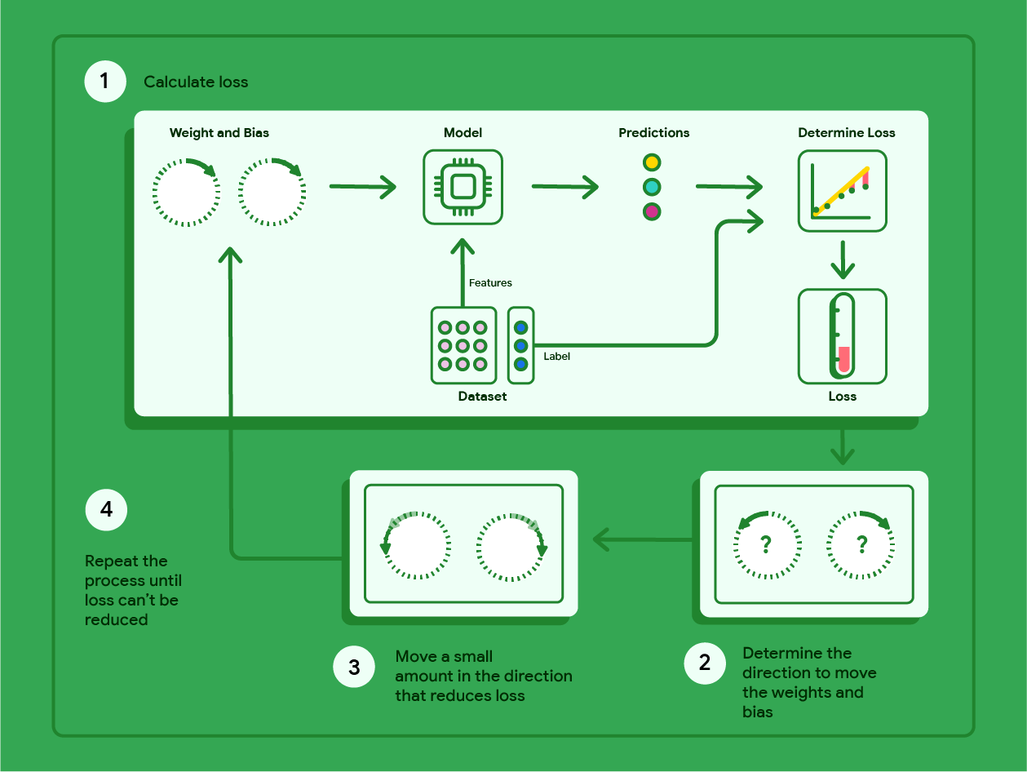

Slide 8
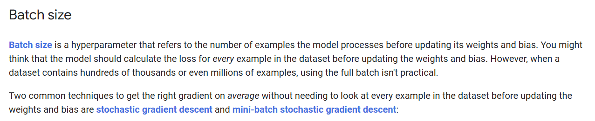

Slide 9


Slide 10
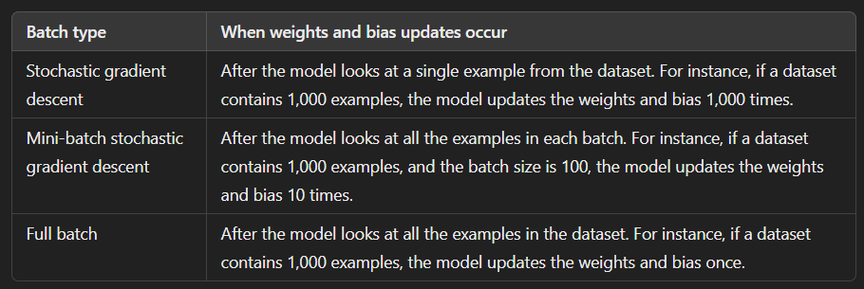

Slide 11
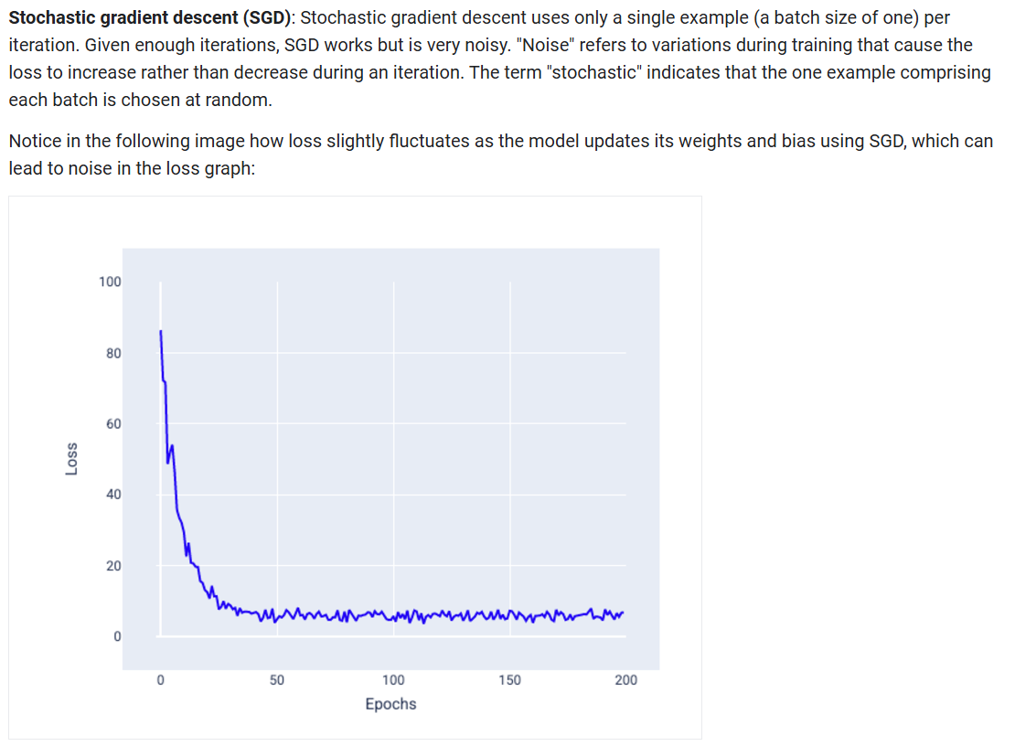

Slide 12
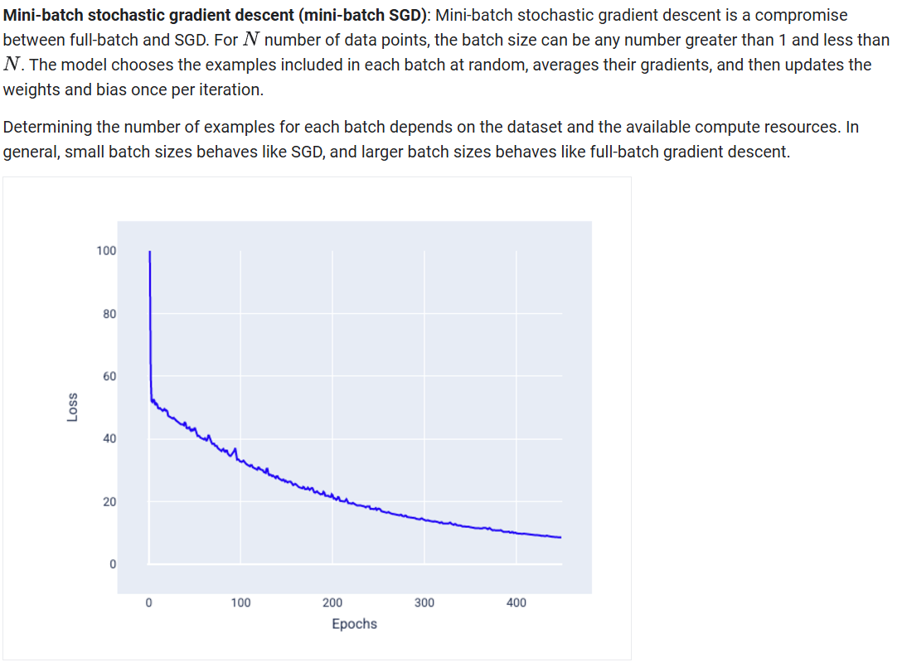

Slide 13
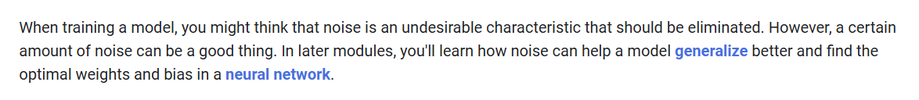

Slide 14
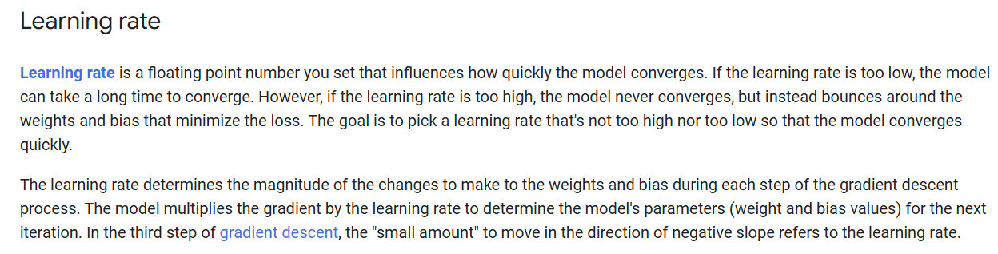

Slide 16

Notes:
https://www.jeremyjordan.me/nn-learning-rate/

Slide 17
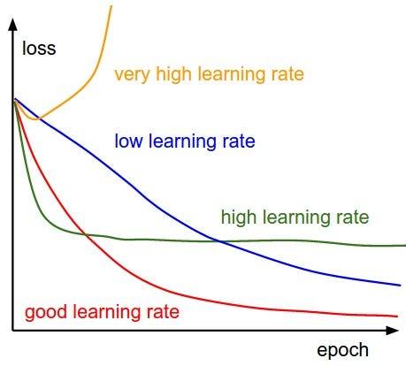
Notes:
https://towardsdatascience.com/https-medium-com-dashingaditya-rakhecha-understanding-learning-rate-dd5da26bb6de

Slide 18
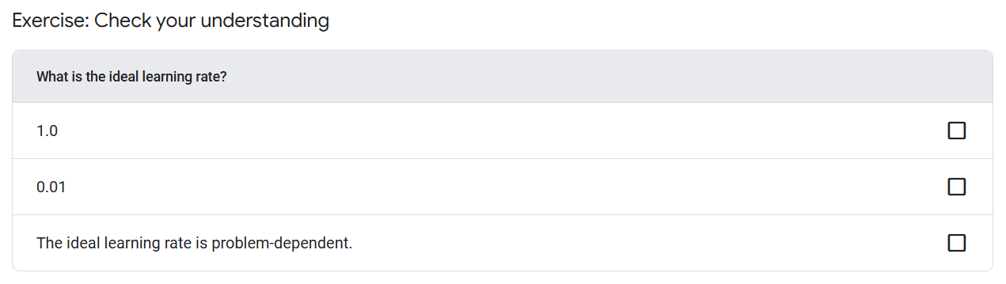

Slide 19
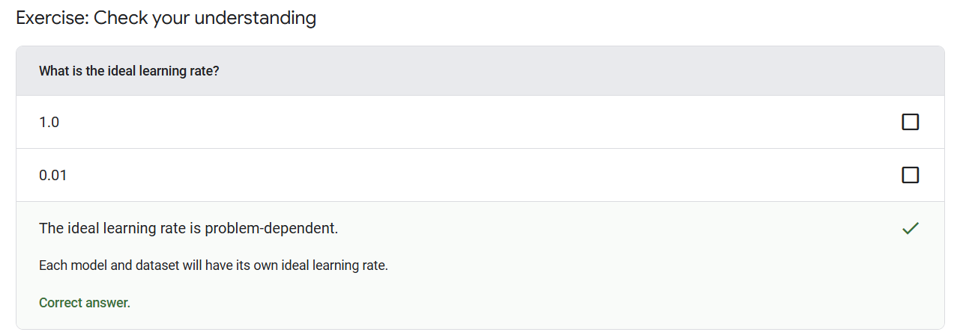

Slide 20
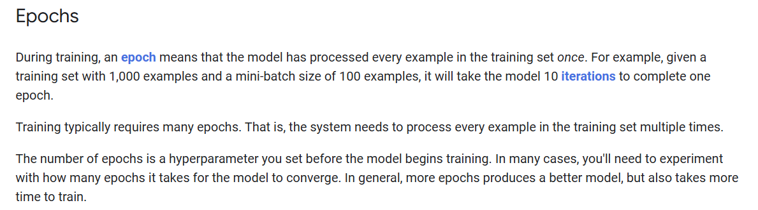

Slide 22
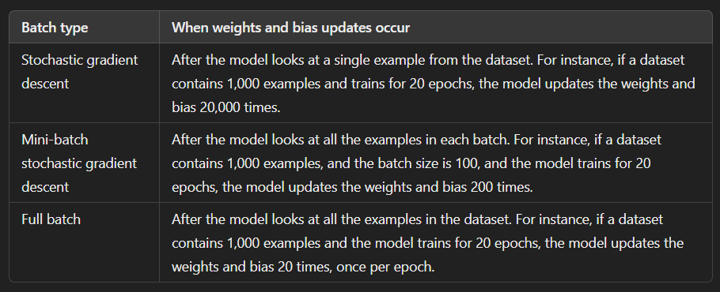

Slide 23
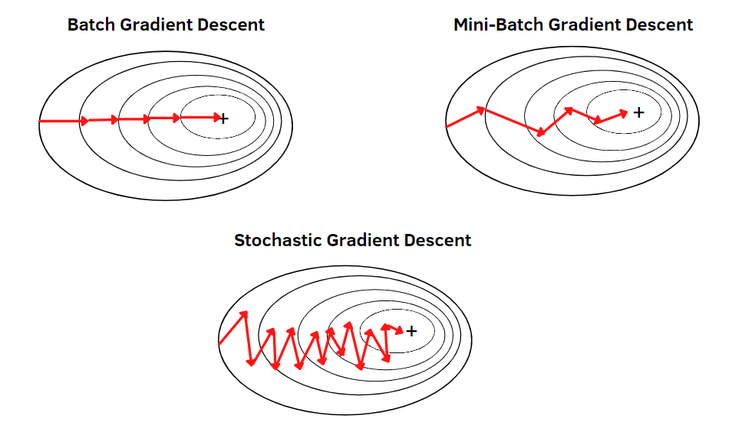

Slide 24
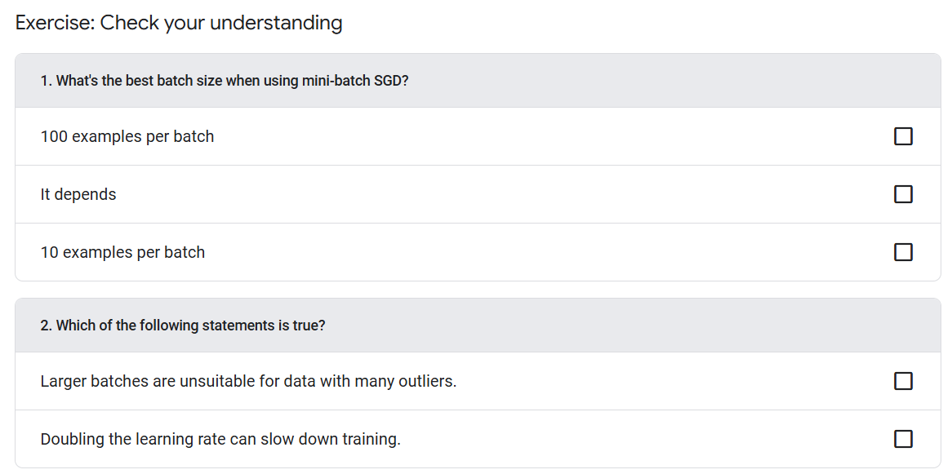

Slide 25
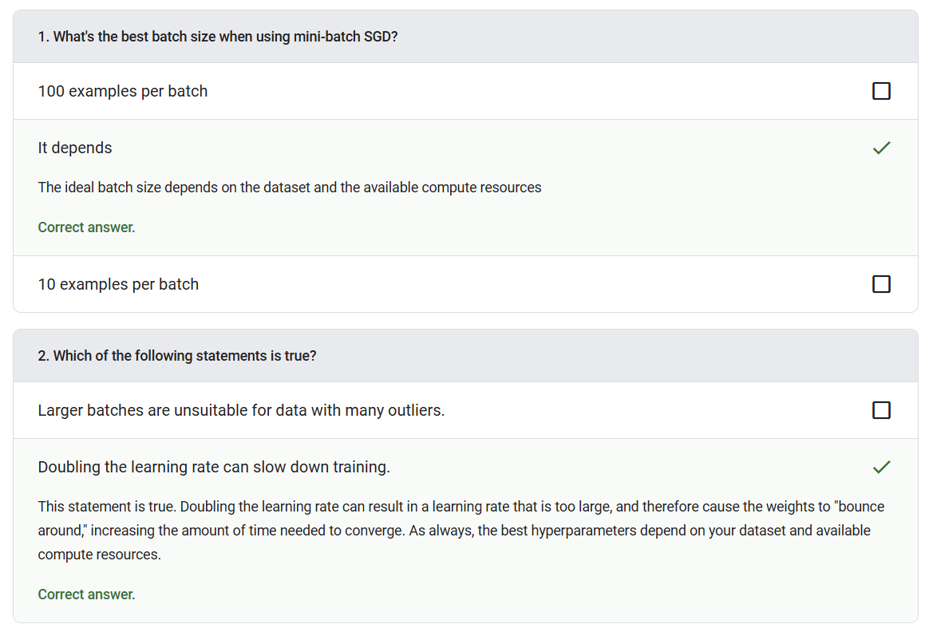

Slide 26




Notes:
https://www.youtube.com/channel/UC35ZpwldGw7ZJ5R-2sLijzw

Slide 27


Membership has its privileges
Notes:
https://www.youtube.com/channel/UC35ZpwldGw7ZJ5R-2sLijzw/join

Slide 28

https://www.youtube.com/@AINewsFresh

Slide 29

https://www.youtube.com/@DailyAINewsPodcast

Slide 30

https://www.youtube.com/@AIPapersPodcastDaily

Slide 31
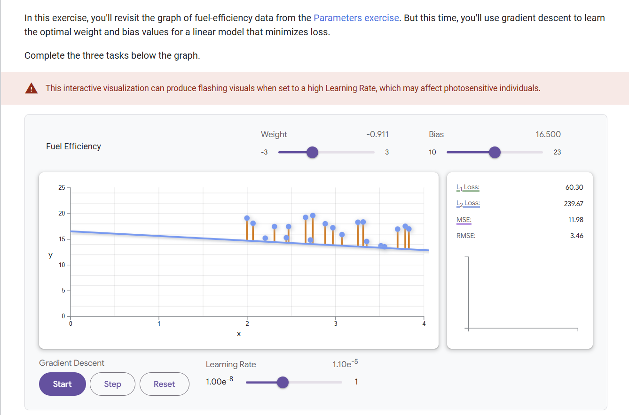
Notes:
https://developers.google.com/machine-learning/crash-course/linear-regression/gradient-descent-exercise

Slide 32
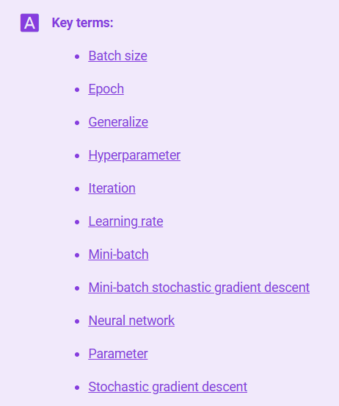
Notes:
https://developers.google.com/machine-learning/glossary

Slide 33
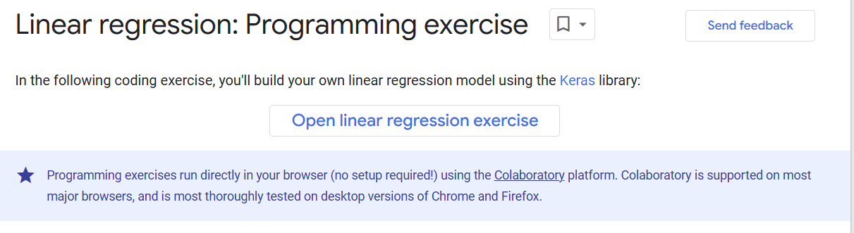
Notes:
https://colab.research.google.com/github/google/eng-edu/blob/main/ml/cc/exercises/linear_regression_taxi.ipynb

Slide 34
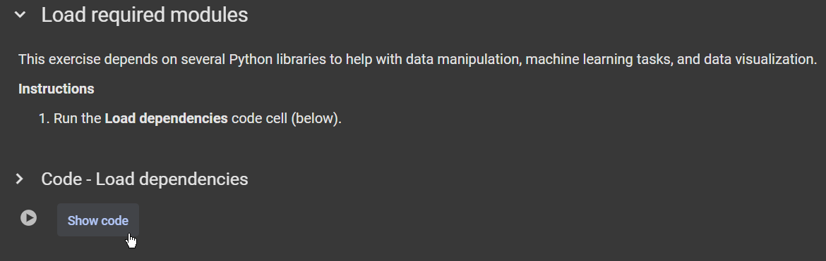

Slide 35


Slide 36
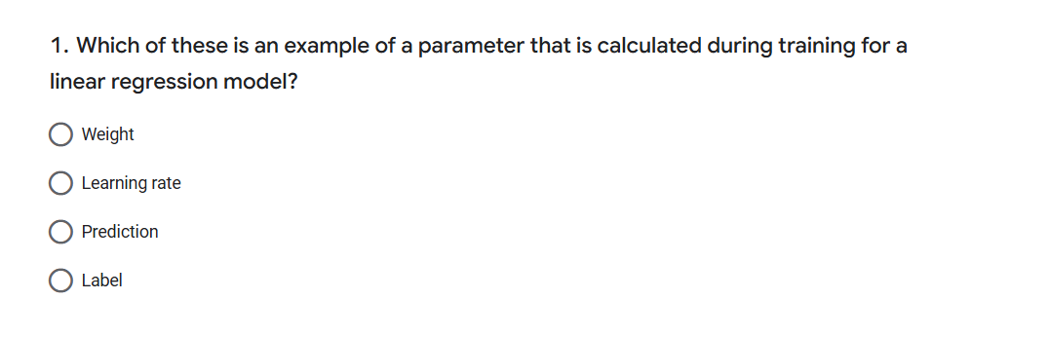

Slide 37
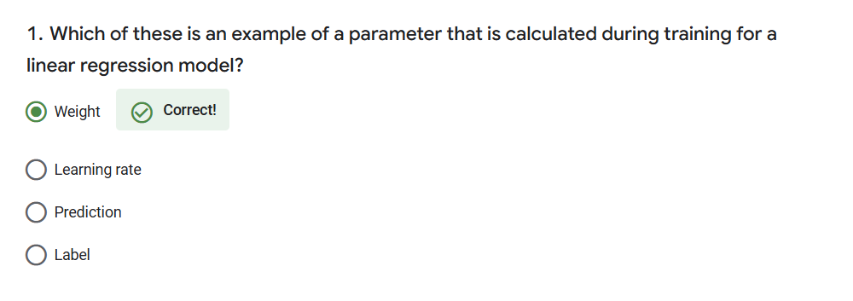

Slide 38
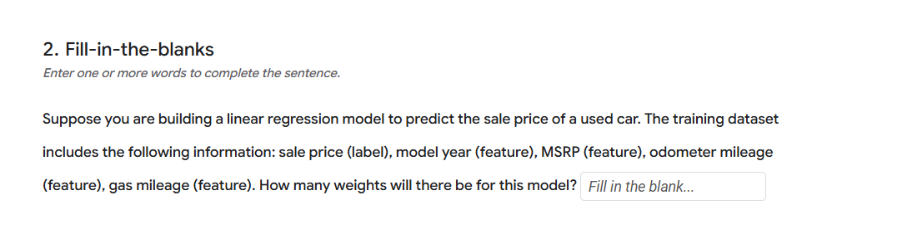

Slide 39
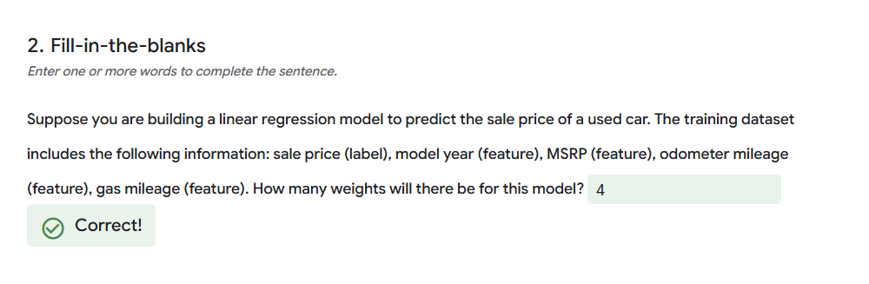

Slide 40
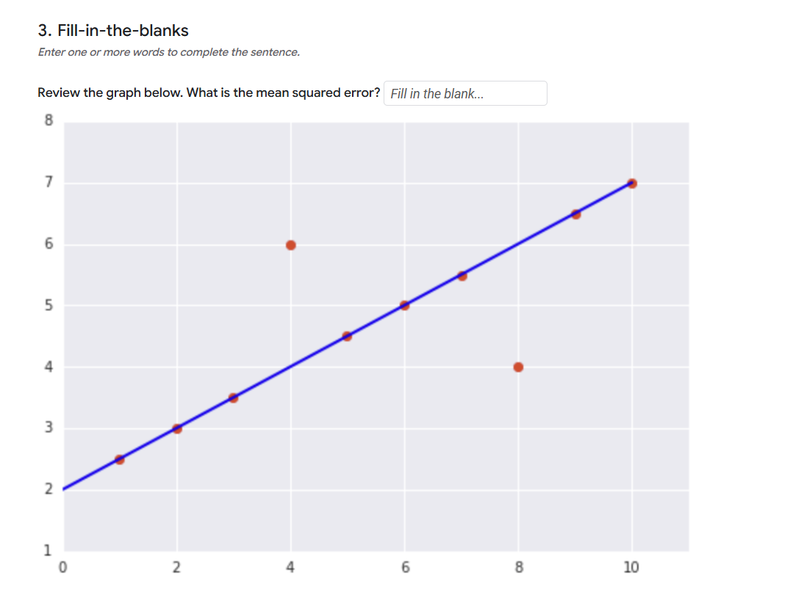

Slide 41
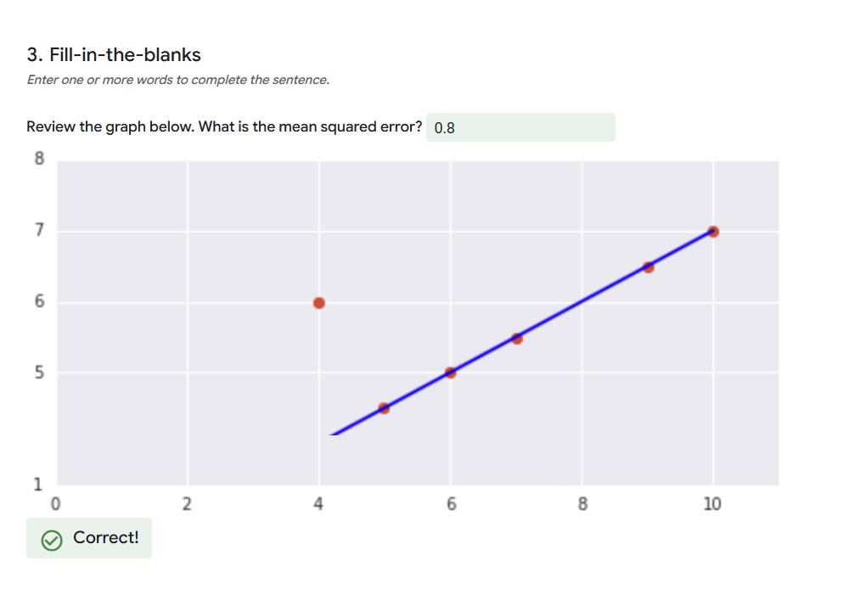

Slide 42
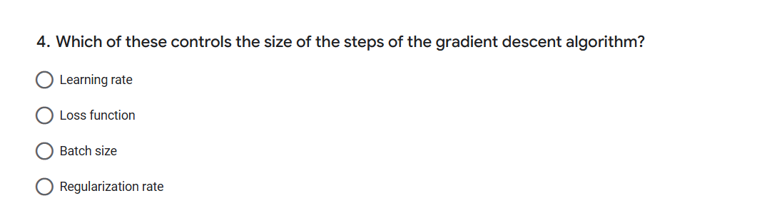

Slide 43
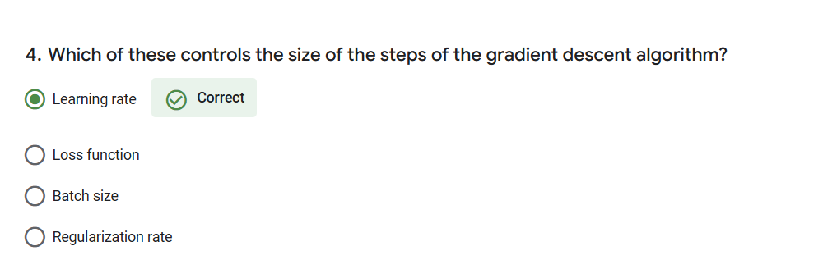

Slide 44
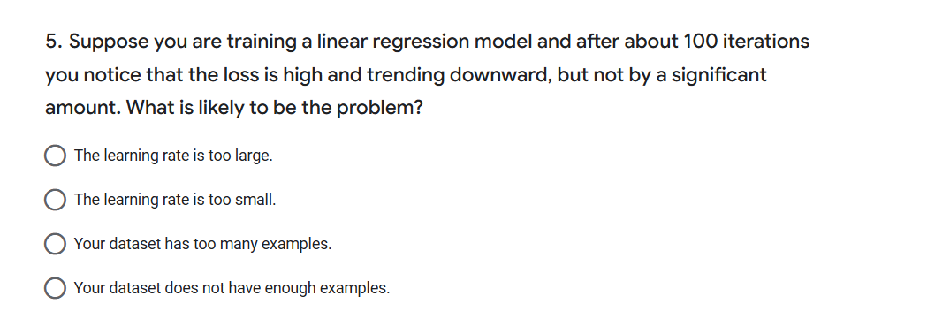

Slide 45
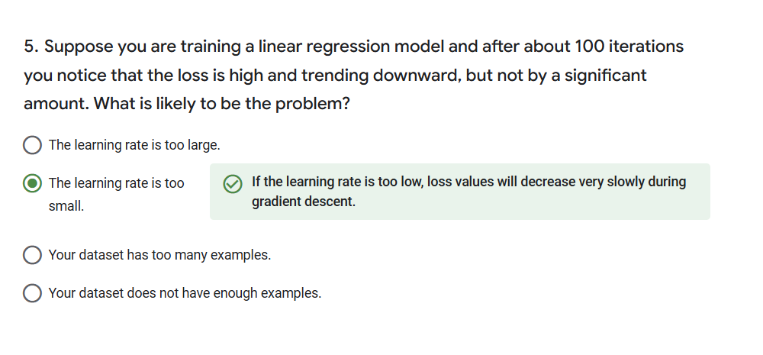

Slide 46


